Slide 1
COLORADO BUDGET: A SNAPSHOT OF STATE APPROPRIATIONS AND HOW THEY'VE CHANGED OVER TIME
The Colorado Budget
Then and Now
^{December 2023 Annual Release}
www.commonsenseinstituteco.org

Slide 2
COLORADO BUDGET: A SNAPSHOT OF STATE APPROPRIATIONS AND HOW THEY'VE CHANGED OVER TIME
Seventh Annual Release: The Colorado Budget Then and Now
Colorado Budget Then and Now illuminates the changes in Colorado state budget appropriations over the last twenty years.
The following figures provide an overview of revenue allocated to state departments through the legislative budgeting process. The trends in appropriations reflect the shifting priorities brought on as a direct result of the laws and budgets passed each legislative session.
Common Sense Institute (CSI) is a non-profit free-enterprise think tank dedicated to the
protection and promotion of Colorado’s economy.
We believe sound fiscal and economic research is essential to uphold Colorado’s economic vitality, future, and individual opportunity.
1

Slide 3
Methodology T HAS CHANGED
The findings of this report are generated from the annual appropriations reports compiled by the Colorado Joint Budget Committee Staff. These reports draw from the state's budget packages, which are drafted by the Governor's office then revised and approved during each year's legislative session. They include appropriations to each of the state government's departments from all funds including the General Fund, Cash Funds, Federal Funds, Reappropriated Funds, and Capital Construction Funds. The report considers appropriations in FY 2023 final because the fiscal year during which they were allocated has ended. FY 2024 appropriations are considered initial because they reflect amounts authorized by the legislature that may change over course of the fiscal year. FY 2025 appropriations are from the Governor’s proposal and have yet to be reviewed by the state legislature.
General Funds: General-purpose revenue is deposited into the General Fund and used for the state’s core programs, such as education, health care, human services, corrections, and general government (e.g., the legislature and Governor’s office). General Fund revenue is the only major state revenue source available to fund capital construction projects which is further appropriated from the GF.
Cash Funds are special-purpose funds that exist outside of the General Fund. They are funded by taxes, user fees, and fines earmarked for specific purposes and programs. Other large categories of cash fund revenue include revenue to TABOR enterprises, employee pension contributions and interest income, voter-approved revenue, property sales, damage awards, and gifts.
Federal Funds are moneys received from the federal government to support specific purposes and programs. For some programs, such as Medicaid, state funding is matched with federal funding.
Reappropriated Funds are transfers of money between departments apart from initial appropriations. To avoid double-counting, reappropriated funds are not included in this report's all-agency totals. Individual departments' totals include reappropriated funds so as to best represent the relative size of each department. Capital Construction Funds are excluded from totals specified as "operating appropriations."
Fund transfers and other obligations are not included in totals except where noted.

Slide 4
Key Findings
Government spending has outpaced inflation and population growth in recent years - adjusted for inflation, total state government appropriations per Coloradan increased by 26% over the last 20 years, from $5,244 to $6,594, rising 22% in just the last 10 years.
Health care has dominated budget growth in recent years while education's share has declined - In the last 20 years, the Department of Health Care Policy and Financing's (HCPF) budget increased by 425% from $3 billion to $15.5 billion and its share of the total budget rose from 22% to 37%. HCPF accounts for 68% of the General Fund appropriation increase in FY24 and 45% of the proposed FY25 increase.
Conversely, the Department of Education's budget grew by only 129% and its share of the total budget decreased from 24% to 18%. Its share of the General Fund declined from 42% to 31% over the past 20 years. If Education had maintained the same share, its FY24 appropriation would have been $1.8 billion higher.
Over the four years from FY23 through FY26, there is a projected $9.3B in TABOR surplus revenue available for refunds. Over the same period, revenue subject to TABOR, available to be spent by the state, is projected to grow from $16.657B to $19.943B—by 6.6% per year, on average.

Slide 5
Annual Appropriations
How Much Money Does the Colorado State Government Appropriate?
Fiscal Year 2024 Appropriations
$39,253,529,029
Each year, the state's legislature approves a budget that dictates how public tax revenue will be allocated to the different government departments. The current budget cycle, fiscal year 2024, runs from July 1, 2023, through June 31, 2024. As of November 2023, the total initial appropriation for FY 2024, inclusive of operating appropriations minus reappropriations plus capital construction appropriations, is $39,253,529,029.
Common Sense Institute :: CommonSenseInstituteCO.org

Slide 6
State Government Appropriations
Flow of Tax Revenue from the Taxable Source to State Departments
Tax Revenue Collection
State Funds Available for Appropriations
State Departments
Income Taxes
Sales Tax
Use Tax
Fees
General Fund
Cash Fund
Reappropriated Funds
Federal Funds
Agriculture*
Corrections*
Early Childhood
Education
Governor*
Health Care Policy & Financing
Higher Education
Human Services
Judicial
Labor & Employment*
Law*
Legislative*
Local Affairs*
Military & Veteran Affairs*
Natural Resources*
Personnel*
Public Health & Environment*
Public Safety*
Regulatory Agencies*
Revenue*
State*
Transportation
Treasury
The image above illustrates the flow of state appropriations from tax revenue sources to the state departments that the legislature authorizes to spend state revenue. There are many different state agencies within each department, but, for the purpose of this report, appropriations are only shown by fund types or departments. For formatting purposes, state department labeled with asterisks are combined in several of the following figures into a single category called "Other Departments." Combined, these other departments represent about 14% of total appropriations.
Common Sense Institute :: CommonSenseInstituteCO.org

Slide 7
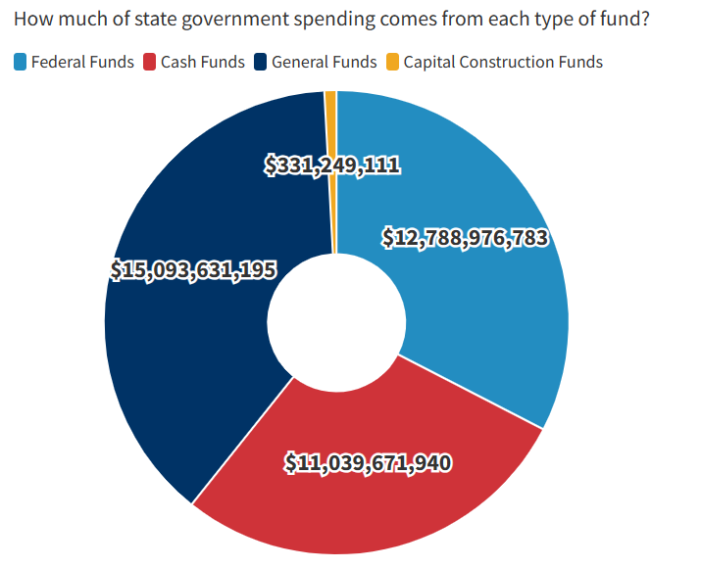
Colorado Total Appropriations by Fund Type in FY24
Total appropriations in FY24 is $39,253,529,029. General fund appropriations are 38.5%, federal funds constitute 32.6%, cash funds constitute 28.1%, and capital construction funds make up .84% of the total appropriations in FY24.
Common Sense Institute :: CommonSenseInstituteCO.org

Slide 8
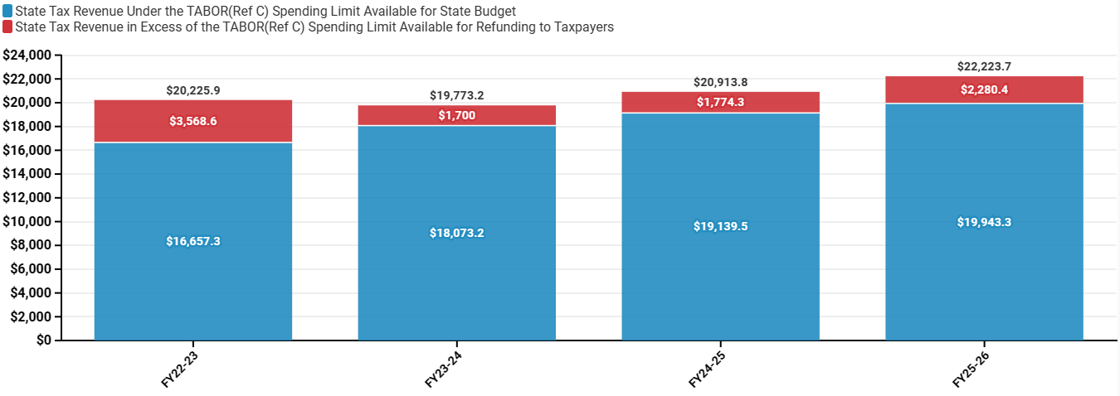
Colorado Revenue Above and Below the TABOR Cap - FY23-FY26 – Units in Millions
Source: September 2023 Legislative Council Economic Forecast
Coloradans are projected to receive TABOR refunds of varying sizes in all four fiscal years currently captured in the most recent Sep. 2023 Legislative Council Forecast. Over the four budgets from FY23 to FY26, there is an estimated $9,323,300,000 in TABOR surplus' available for refunds. While at the same time revenue subject to TABOR available to be spent by the state is projected to grow from $16.657 B to $19.943 B, or by 6.6% per year on average, in line with inflation and population growth rates.
Common Sense Institute :: CommonSenseInstituteCO.org

Slide 9
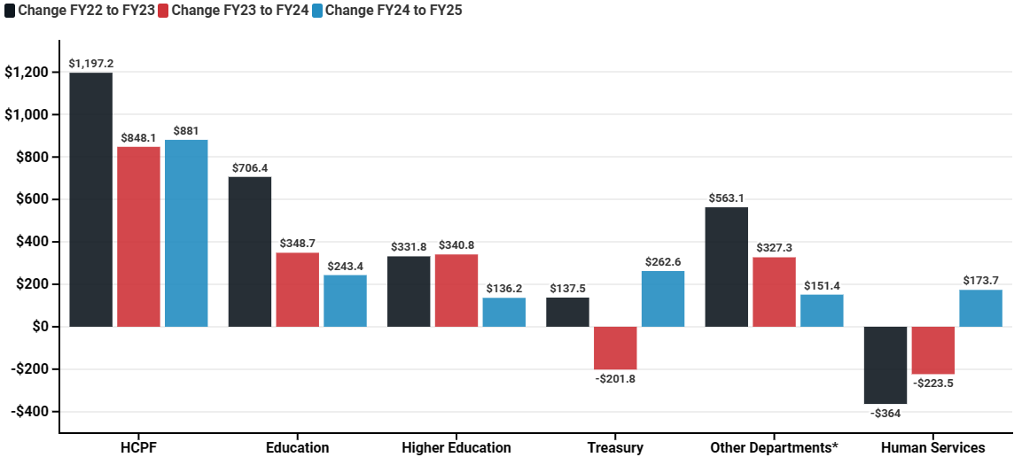
Annual Change in Operating Appropriations by Department
From FY22 to the FY25 Governor's Budget Proposal – Units in Millions
Source: Colorado JBC Annual Appropriations Report Note: Data omit capital construction
Total operating appropriations was $34.64 billion in FY22 and $37.28 billion in FY23. Current estimates suggest a net $1.65 billion increase from FY23 to FY24. This is over $500 million less than the increase between FY22 and FY23, a significant portion of which came from one-time federal funds. Between FY23 and FY25, the Department of Health Care Policy and Financing (HCPF) received $46.5 billion (37%) of the total $171.3 billion of departmental funding awarded by the state. Between FY22 & FY25, HCPF's budget will have grown by 21.7% whereas the Department of Education's budget will have grown by 20.2%.
Common Sense Institute :: CommonSenseInstituteCO.org

Slide 10
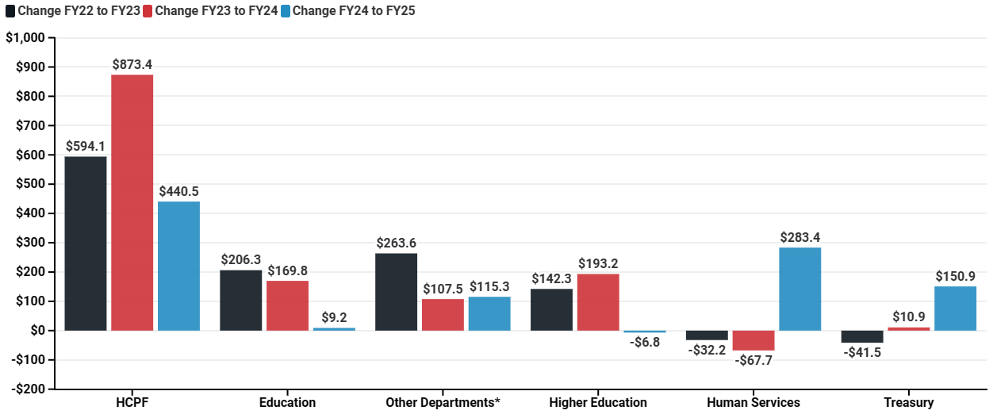
Annual Change in General Fund Appropriations by Department
From FY22 to the FY25 Governor's Budget Proposal – Units in Millions
Source: Colorado JBC Annual Appropriations Report Note: Data omit capital construction
From FY22 to FY24, the General Fund's operating total grew by 23.4% from $12.2 billion to $15.1 billion. The Governor's budget request proposes to increase this value by another 6.5% to $16.1 billion in FY25. HCPF will receive an additional $440 million, which is the largest departmental share of this increase (equal to 44.9% of its total).
Common Sense Institute :: CommonSenseInstituteCO.org

Slide 11
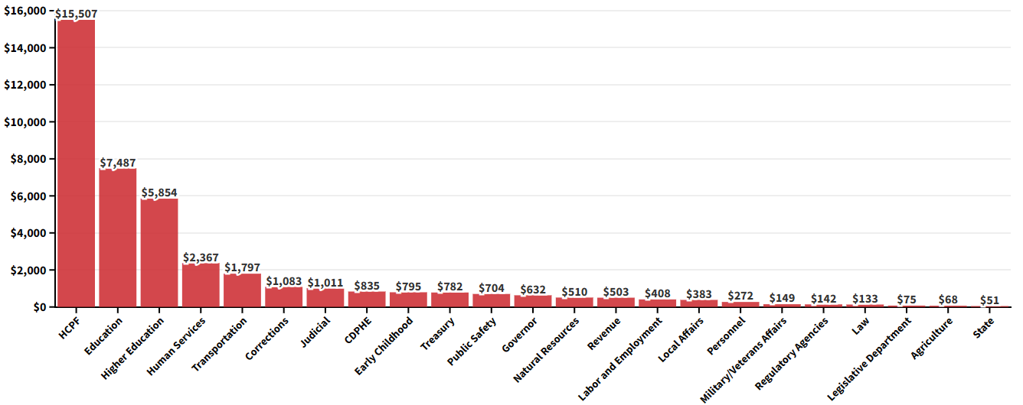
Total Appropriation to Each Department in FY24 – Units in Millions
Source: Colorado JBC Annual Appropriations Report
The top five departments, HCPF, Education, Higher Education, Human Services, and Transportation, were appropriated 79.5% of the total budget in FY24. Nine departments, including Labor and Employment and Agriculture, received less than 1% each of the total appropriation. Under the Governor's FY25 budget request, these top five departments would receive about 83.4% of the total appropriation.
Common Sense Institute :: CommonSenseInstituteCO.org

Slide 12
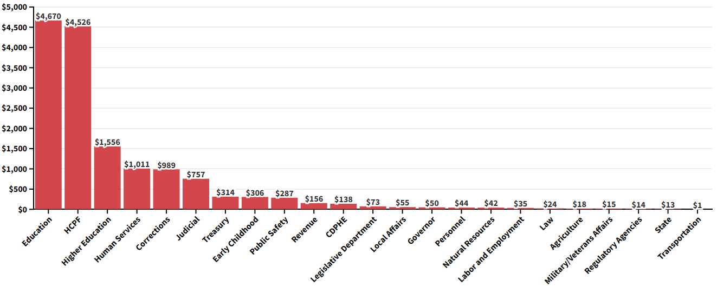
General Fund Appropriation to Each Department in FY24 – Units in Millions
Source: Colorado JBC Annual Appropriations Report
The departments of Education, Corrections, HCPF, Higher Education, Human Services, and the Judicial branch together received 89.5% of General Fund appropriations in FY24. Money is often transferred from the General Fund to the Highway Trust Fund to be used for transportation projects, but such transfers are not counted as appropriations.
Common Sense Institute :: CommonSenseInstituteCO.org

Slide 13
Total Appropriations by Department in FY04 and FY24 – Units in Millions
Source: Colorado JBC Annual Appropriations Report
In the last 20 years, the Department of Health Care Policy and Financing's share of total appropriations has increased by 15.6 percentage points. The next-fastest–growing share, that of the Department of Higher Education, rose by only 2 percentage points during the same period. The Department of Human Services' share, inversely, fell by 7.9 percentage points.
Common Sense Institute :: CommonSenseInstituteCO.org

Slide 14
General Fund Appropriations by Department in FY04 and FY24 – Units in Millions
Source: Colorado JBC Annual Appropriations Report
Although General Fund appropriations increased for all departments between FY04 and FY24, some departments' shares of the total budget decreased even while their appropriations increased. The General Fund's appropriations to the Department of Education and HCPF grew by 93% and 265% between FY04 and FY24, respectively. Because of this disparity, HCPF’s share of General Fund appropriations grew from 22% to 30% while Education’s shrank from 43% to 31%.
Common Sense Institute :: CommonSenseInstituteCO.org

Slide 15
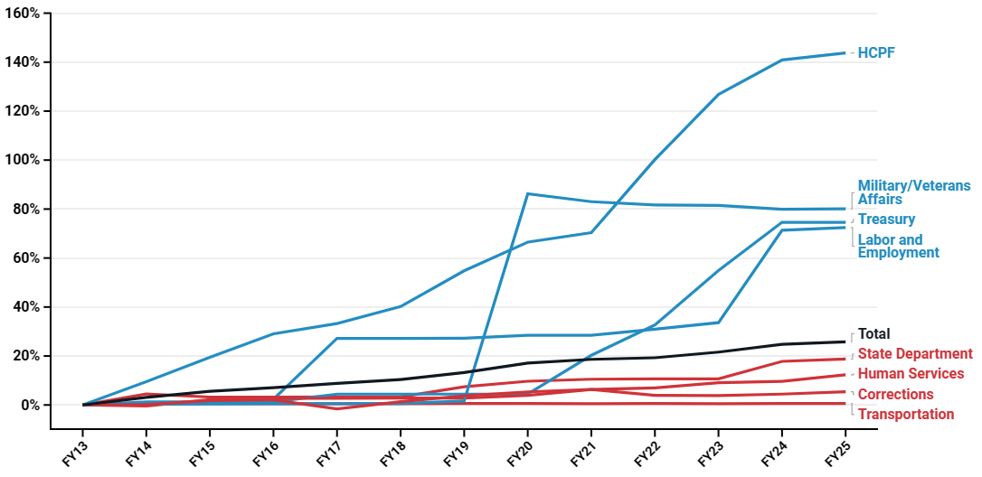
Colorado Full Time Employment(FTE) Growth by Department - Top and Bottom Four
Over the last 10 years, Colorado state-government FTE has grown from 55,000 to 65,510—a 19.1% increase. The Department of Health Care Policy & Financing's FTE has grown the fastest (124% since FY15). Employment in the Department of Transportation has remained almost completely static; the department added zero new FTE in FY25 and grew by only 0.5% over the last decade.
Common Sense Institute :: CommonSenseInstituteCO.org

Slide 16
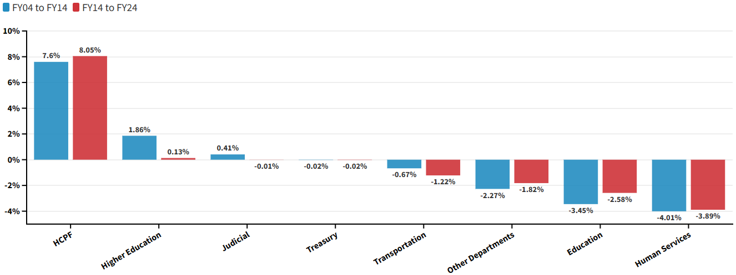
The Differences in the Share of Colorado's Total Appropriations
The values are the difference in dollars as a percentage change between FY04 to FY14, and FY14 to FY24. A positive value indicates that the share increased over this period and a negative value indicates a declining share.
From FY14 to FY24, HCPF and Higher Education were the only major departments to increase their shares of total appropriations. Between FY04 and FY24, HCPF's share of total appropriations grew by 15.65 percentage points; this growth accelerated particularly between FY14 and FY24. During that same period, Education's share decreased by 6.03 percentage points.
Common Sense Institute :: CommonSenseInstituteCO.org

Slide 17
The Differences in the Share of Colorado's General Fund Appropriations
The values are the difference in dollars as a percentage change between FY04 to FY14, and FY14 to FY24. A positive value indicates that the share increased over this period and a negative value indicates a declining share.
*Department established in 2022
As a share of total General Fund appropriations, Colorado's Department of Education lost a cumulative 11.95 percentage points between FY04 and FY24, the largest loss of any department. By contrast, HCPF's share grew by 7.97 points over this same period. Colorado established the Department of Early Childhood in July of 2022, which now accounts for 2.03% of all General Fund appropriations.
Common Sense Institute :: CommonSenseInstituteCO.org

Slide 18
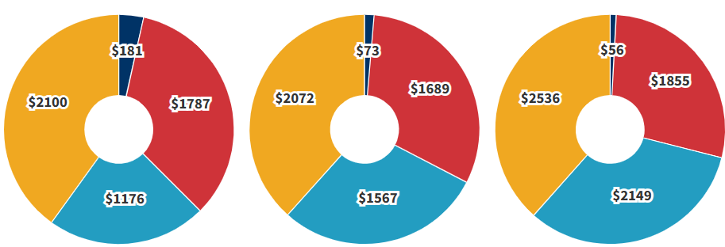
Total State Appropriations per Coloradan
Appropriations are adjusted for population and inflation
FY04
FY14
FY24
$5,244
$5,400
$6,594
Source: Colorado JBC Annual Appropriations Report
Adjusted for inflation and population growth, total state government appropriations per Coloradan increased by 26% from FY04 to FY24 and by 22% between FY14 and FY24. Population estimates come from the Colorado Demographer's Office and inflation is derived from the Denver MSA CPI published by BLS.
Common Sense Institute :: CommonSenseInstituteCO.org

Slide 19
Colorado Budget Then and Now
Email us at info@csinstituteco.org

