Slide 1
w
State of the Cities

Slide 2
We believe sound fiscal and economic research is essential to uphold Colorado’s economic vitality, future, and individual opportunity.

Slide 3
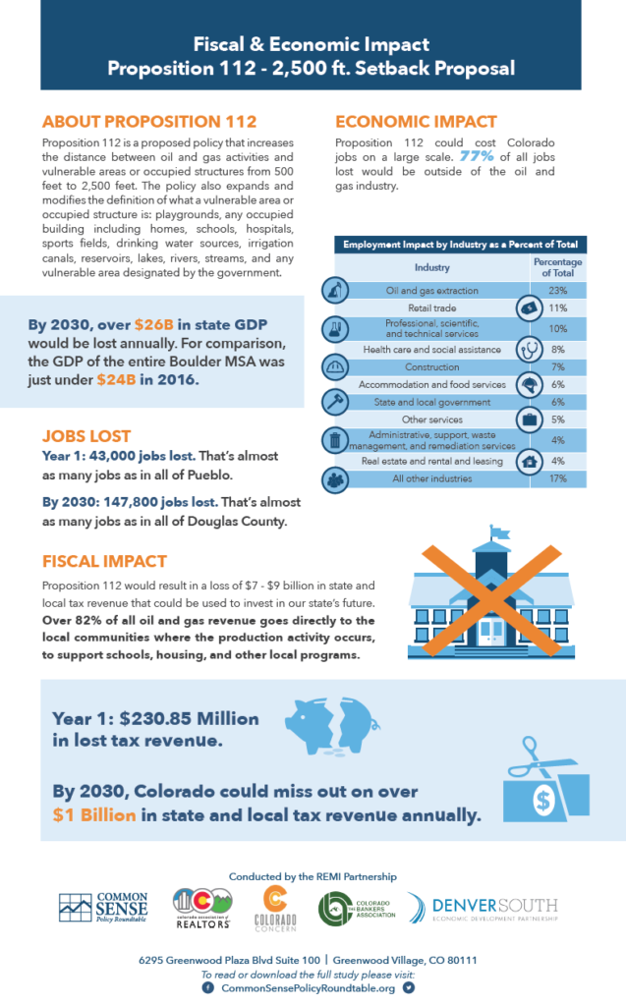
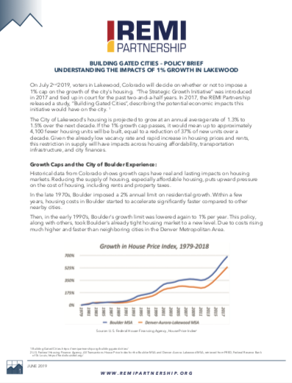
CSPR’s Recent Research
Notes:
Lakewood, 112, FAMLI, Public Option

Slide 4
The Facts
#1
Colorado is a special place to live, work, and raise a family.

Slide 5
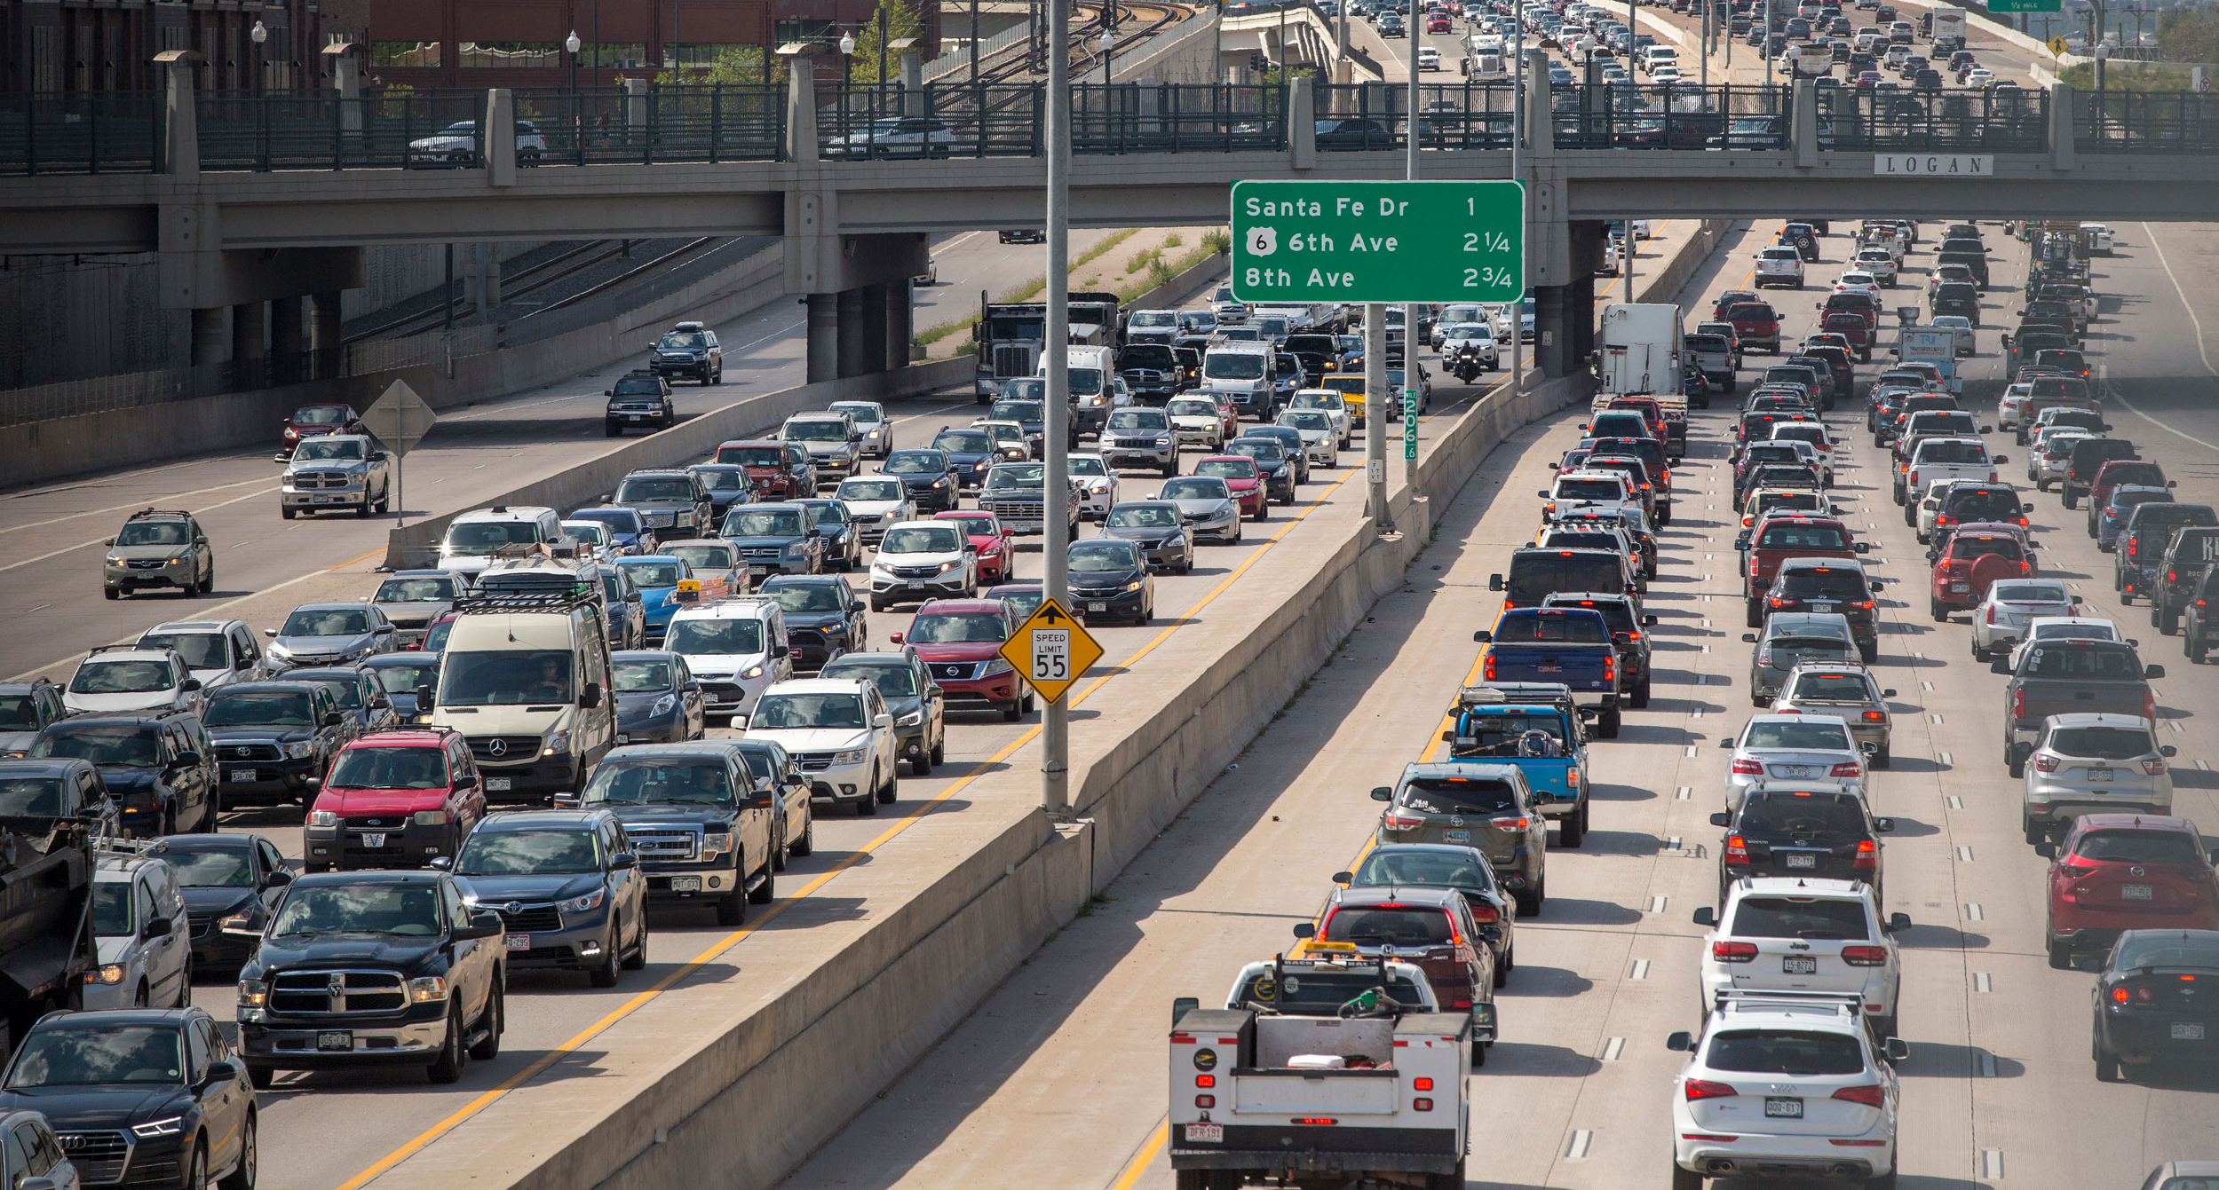
How Special?

Slide 6
The Facts
#2
How badly do people want to live in Colorado?
Today our population is 5.8 million
In 2000 it was 4.3 million
There is nearly one-third more people in CO today than in 2000
And in just 10 years it is projected to be 6.6 million, growing almost by 1 million people.

Slide 7
Local Growth

Slide 8
w
Building Gated Cities
Understanding the impacts of Growth Caps

Slide 9
IMPACT
The City of Lakewood is projected to grow at an annual average of
1.3% to 1.5% in the next decade.
The 1% Growth Cap passed, means up to approximately
4,100 fewer housing units will be built.
Equal to a reduction of 37% of new units over a decade.

Slide 10
What’s impacted?
If the median home price were to increase by 20% as a result of the 1% growth cap, that would amount
up to a
$527 to $761 increase
in property taxes, per year.
The share of in-commuters to Lakewood grew from
9% to 17% from
2002 to 2014
By 2016, the gap between what a police officer and firefighter could afford grew to
$107,000 and $139,000
respectively.
Notes:
Add firefighter in the middle

Slide 11
Initiative 122 - 1% Housing Growth Cap Across 10 Front Range Counties

Slide 13
WHY THIS STUDY IS NEEDED
Historically, most economic research on Colorado’s oil and gas sector has been statewide in nature, leaving a void of information at the local level.
With Senate Bill 181 expanding the role of local governments in siting and regulating new energy production facilities, this study begins to fill that void, starting with property tax revenues that support a wide range of essential public services.

Slide 14
TAX ASSESSMENT RATE FOR OIL AND GAS

Slide 15
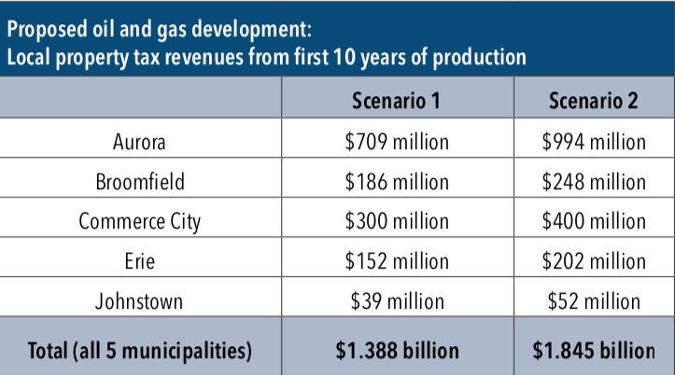
FINDINGS
Property tax revenue of between $1.39 billion and $1.85 billion
over 10 years.

Slide 16
FUNDING FOR MUNICIPAL ROADS
Revenues for individual municipalities would also see a significant boost:
An additional $194 million to $258 million over 10 years in the 5 cities.
For scale, this amount of new revenue would be enough to make long-term repairs to hundreds of miles of municipal roads.

Slide 17
K-12 EDUCATION FUNDING
Public schools would be the largest beneficiary,
potentially receiving $822 million to $1.1 billion over 10 years.

Slide 18
w
Follow us and subscribe online at:
www.commonsensepolicyroundtable.org
Questions?
info@csprco.org

